Slide 1
Car Rental Data Summary
Name;
Name;
Class/Section;
Project;
Due Date:

Slide 2
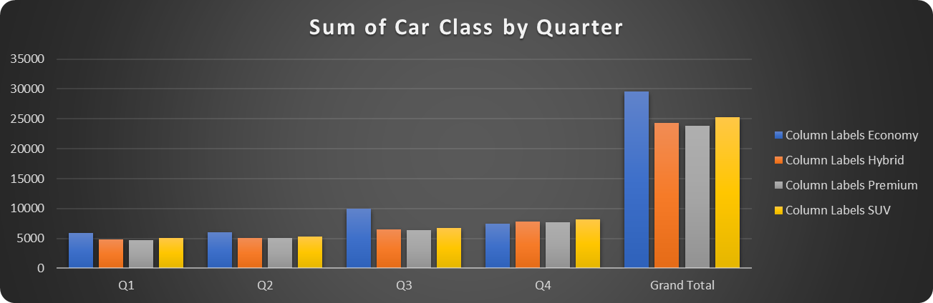
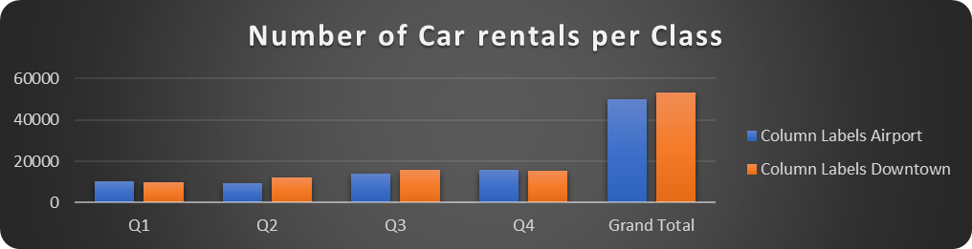
Number cars rented
Notes:
There was a variation in the number of cars by each category. The economy class has the highest number of cars followed SUVs. The Hybrid and Premium follow respectively. Considering the quarters, quarter one registered the lowest number of cars while quarter 4 registered highest number o cars.

Slide 3
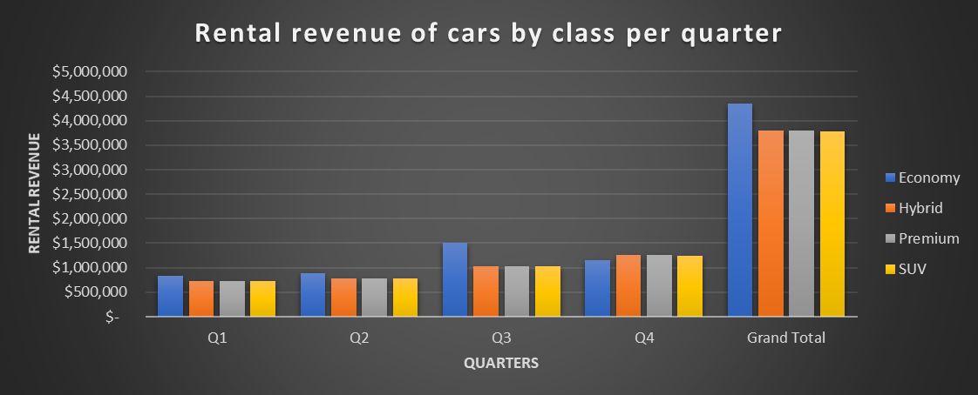
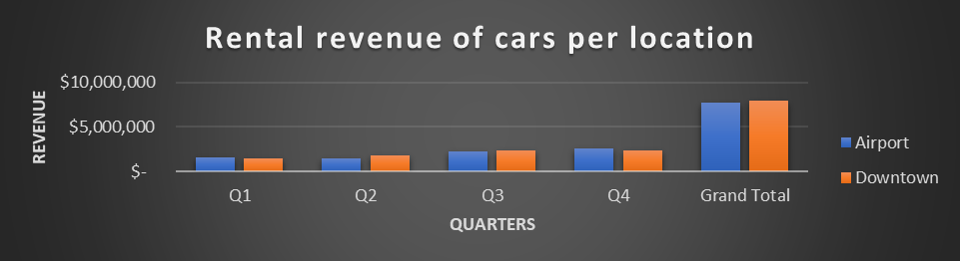
Rental Revenue
Notes:
This slide compares revenues in terms of car variety per quarter as well as location. The first quarter had the lowest revenue while the fourth quarter registered highest revenue. The revenue from different car categories varied. Economy cars registered highest revenue as compared to the other car varieties. Similarly, downtown cars registered highest revenue as compared to the Airport cars.

Slide 4
Conclusion
Economy cars registered highest revenue
Highest revenue generated in fourth quarter
Downtown cars generated highest revenue
Notes:
In conclusion, it is evident that the fourth quarter is the best season to generate high revenue returns while the economy cars prove to be the best with high rental returns. Notably, rental cars generated high revenues as compared to the Airport rental cars. Therefore, for investors, the best time to reap high rental benefits is on fourth quarter with cars operating at downtown.

